Slide 2
Fast Track Cities 90-90-90 Progress Update South Africa
Gloria Maimela, MBBCH, MBA
Wits RHI, University of the Witwatersrand

Slide 3
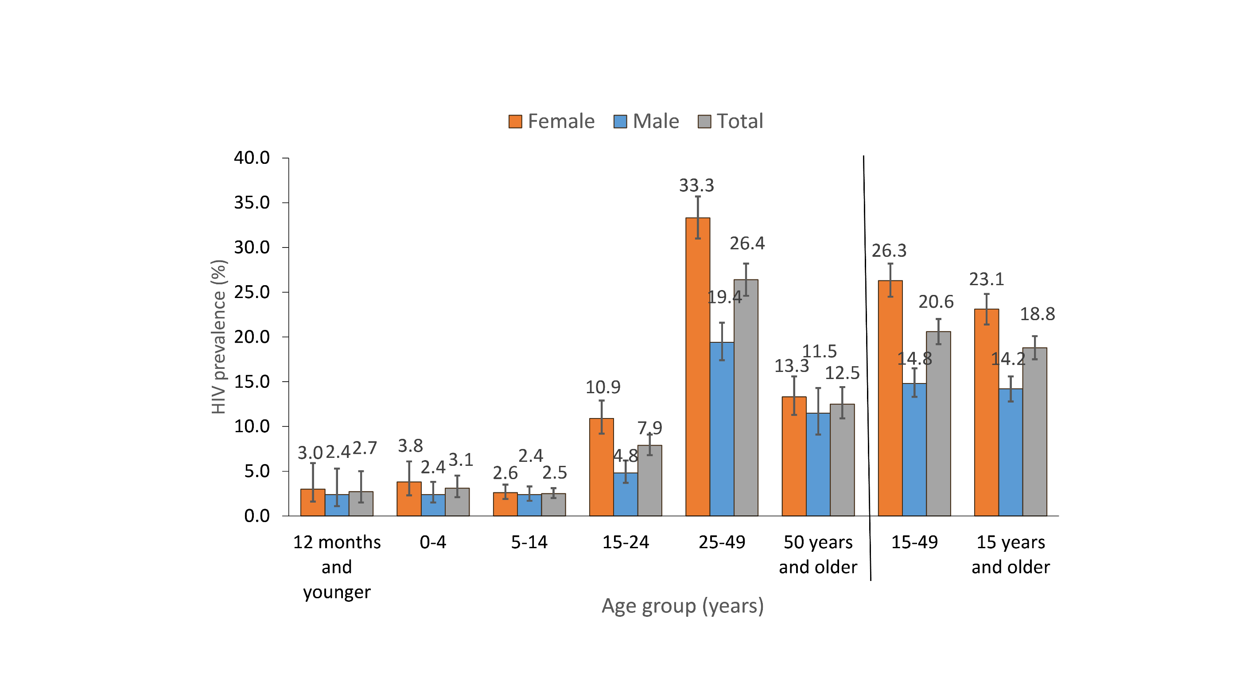
South Africa is home to 20% of people living with HIV
HIV by age and sex, South Africa, 2017
Source: HSRC 2017
Notes:
20% PLHIV globally
Largest ART programme in the world
Antenatal HIV Prevalence (2017) = 30.7%

Slide 4
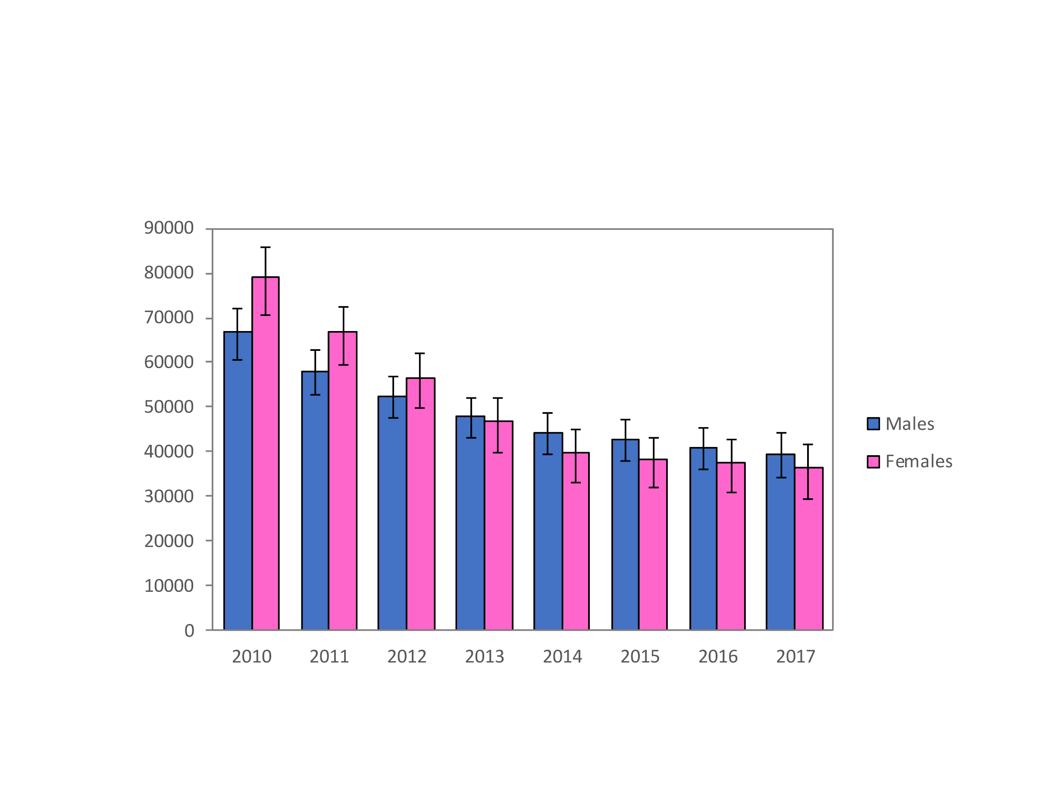
South Africa: adult AIDS deaths, by year
Source: Thembisa Model 4.2
Notes:
South Africa has largest

Slide 5
South Africa: annual new HIV infections
HIV Incidence in 15-29 age group
HIV incidence 1.39 (95% CI 1.16 – 1.62)
…Ongoing incidence in young women
Source: Thembisa Model 4.2; National Antenatal HIV Prevalence Survey (2017)

Slide 6
South Africa: Total population 90-90-90 Cascade
April 2019
Source: National Department of Health, SA

Slide 7
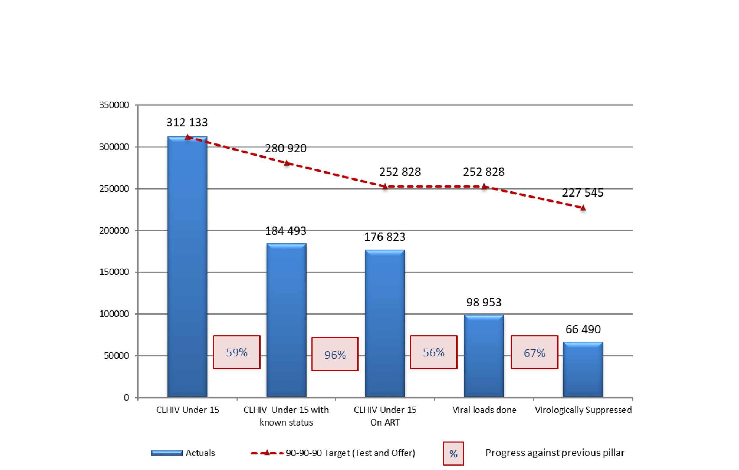
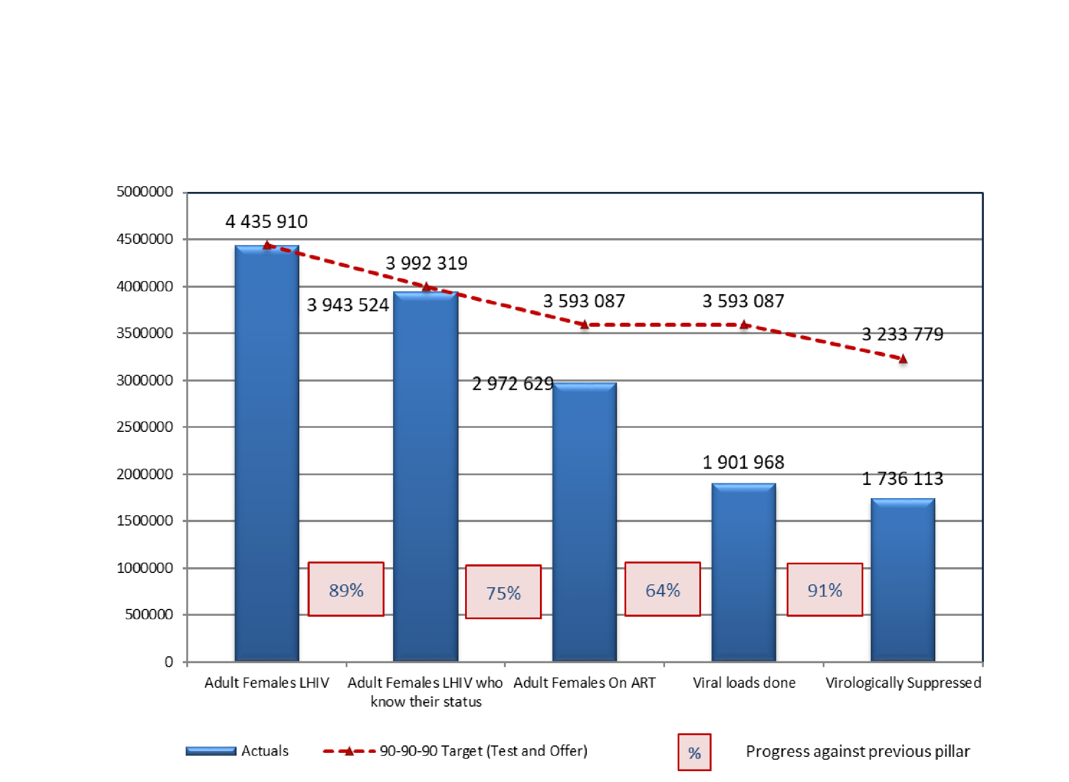
90-90-90 Cascade – Adult Males (Apr 2019 - South Africa)
90-90-90 Cascade – Adult Women (Apr 2019 - South Africa)
90-90-90 Cascade – Children under 15 (Apr 2019 - South Africa)
Source: National Department of Health, SA

Slide 8
Percentage of HIV positive individuals at different levels of engagement in HIV care
Source: Thembisa Model 4.2

Slide 9
Programme achievements
Achievements | Highlights
Progressive and enabling policies | HIV self screening, universal test and treat (UTT), same day ART initiation
Political will | Minister circular calling for action and accountability
Making post exposure prophylaxis (PrEP) available to vulnerable populations | PrEP available to adolescent girls and young women (AGYW), men who have sex with men (MSM) and sex workers, plans to scale to men
Scaling of voluntary medical male circumcision (VMMC) | >3.9million VMMCs since 2010
Scaling of differentiated service delivery models | Increased number of external medicine pick-up points from 178 in April – 524 in May 2019
Scaling of community oriented models | Training of community health workers (CHWs) to support linkage and retention in care
Transition to Dolutegravir-based regimen | Training commenced 1st July
“UNAIDS report shows South Africa is making huge advances in the fight against the HIV/Aids epidemic” eNCA media release, 17 July 2019.

Slide 10
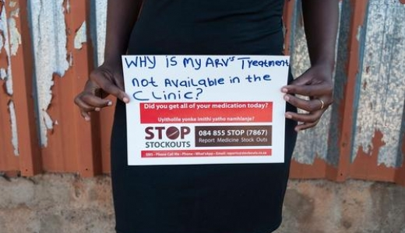
Key Challenges
Suboptimal Data Quality
Overburdened Health Systems
Linkage to treatment Retention in care
Weak Accountability
Ensuring medicine supply and management = demand

Slide 11
Siyenza…we are doing it
Source: PEPFAR CDC - USAID

Slide 12
Operation Phuthuma
10-point Plan
Source: National Department of Health, PEPFAR CDC-USAID

Slide 13
Acknowledgements
Dr Gloria Maimela
Director: Health Programmes, Wits RHI
+27 (0) 72 528 0727 | gmaimela@wrhi.ac.za

